Slide 1
Network Transformation Technical/Process Meeting
11Jan2024

Slide 2
RPD Upgrade/Replacement
ATX Local Power
Teleste amps for mid-split
Fiber splicing on DSeg actions

Slide 3
RPD Upgrade/Replacement
Digital optics (SFP, SFP+, etc.) are tunable and reusable.
When upgrading or replacing a node ordering SFPs are not necessary.
The ones in the existing node can be used.

Slide 4
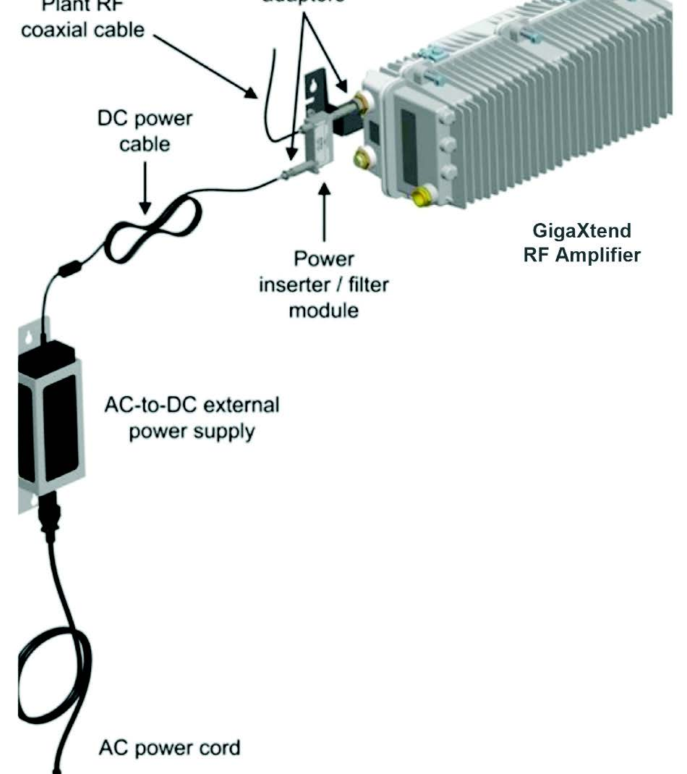
ATX Local Power
Some current ATX/Cisco amps are locally powered.
In those cases ATX has a locally powered option for the mid-split amps.
Order 300-2218 when needing to locally power an ATX amp.
Part is on MJEP BOM
Part number is a quantity of 10
Order one for every 10 amps needing local power

Slide 5
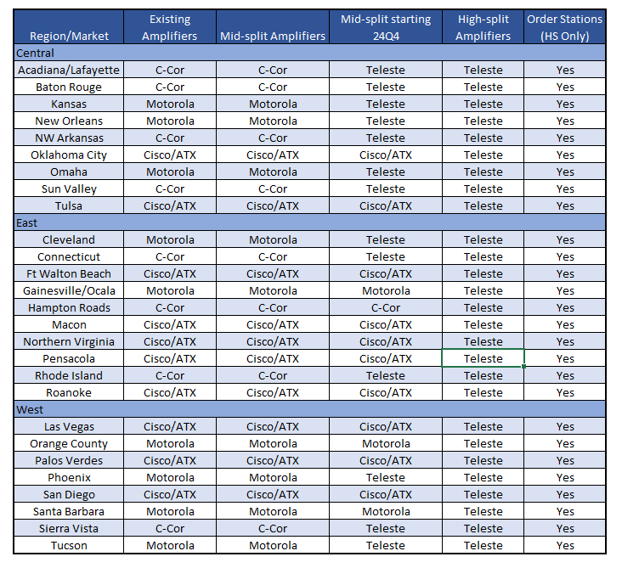
Teleste Amps for Mid-split
Starting with Q4 2024 designs the following markets will use Teleste 1.8GHz amps.
Lode, GNIS, and other documentation are being updated.
Any mid-split jobs in Q4 2024 in the following markets should be returned to Cox designers until specs are updated.
Arizona
Sun Valley
Omaha
Kansas
Arkansas
Greater Louisiana
New Orleans
Cleveland
Connecticut
Rhode Island

Slide 6
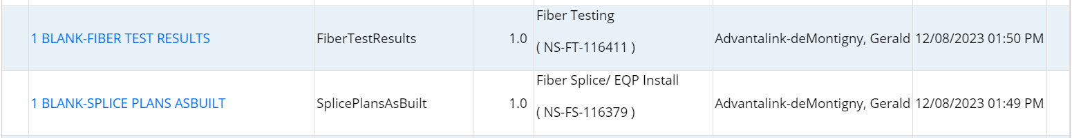
DSeg Splicing
Existing RPDs that are being segmented do not need splice docs.
As-built splice docs on RPD DSegs will show as blank.

